Slide 1

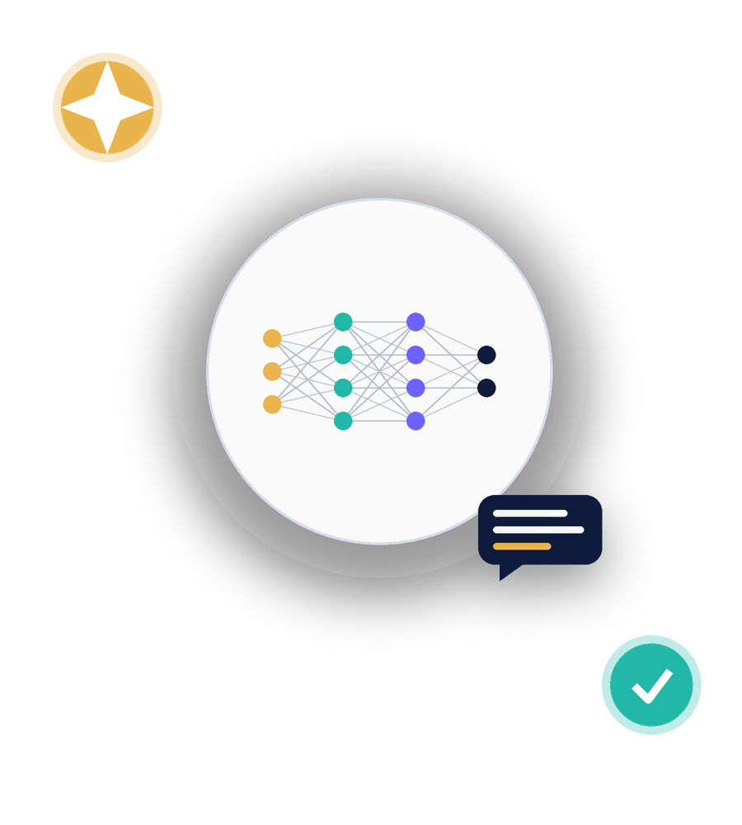
SESSION 0
Introduction to Artificial Intelligence & Generative AI
Three-Day Student Workshop
AI, LLMs, tokens & prompting, practical prompting, and responsible AI use
Rohan Sudhan | Rida Arshad
Notes:
Welcome the students. This is Session 0: a foundation before the two hands-on days. Introduce yourselves - Rohan and Rida. By the end, students will understand what AI and Generative AI actually are, how LLMs work, how to prompt them well, and how to use them responsibly.

Slide 2









AGENDA
What We'll Cover Today
1 Introduction to AI
2 Generative AI & LLMs
Everyday life, engineering, and how AI relates to ML, DL and GenAI
What large language models are and how they're trained
3 How LLMs Process Text
4 Understanding AI Prompts
Tokens, context windows and next-token prediction
The structure of a good prompt
5 Practical Prompting
6 Capabilities & Limitations
Turning a weak prompt into a strong one
Hallucinations, bias and why you verify
7 Responsible & Ethical Use
8 Activity & Recap
Academic integrity and privacy
You improve a prompt and we wrap up
Introduction to AI & Generative AI | Session 0
2
Notes:
Quick run-through of the eight topics. Let students know this session is mostly interactive: short explanations followed by live prompting demos and one hands-on activity at the end.

Slide 3



1 | INTRODUCTION TO AI
AI Is Already Around You
Everyday life
ASK THE ROOM
Voice assistants, recommendation feeds, spam filters, maps and navigation
What is one AI tool you already use every day, without thinking of it as AI?
Engineering
Predictive maintenance, autonomous systems, generative design, quality inspection
• Autocorrect and predictive text
• Photo tagging and face grouping
Why it matters now
• Streaming service recommendations
AI tools are becoming part of how engineers research, build and write
• Maps traffic prediction
Introduction to AI & Generative AI | Session 0
3
Notes:
Open with this question to get students talking. Most will not have thought of autocorrect or maps as AI. This sets up why the next slide separates AI from ML, DL and Generative AI.

Slide 4
1 | INTRODUCTION TO AI
AI, ML, Deep Learning & Generative AI
Artificial Intelligence
Machines that mimic human tasks
Machine Learning
Systems that learn patterns from data
Deep Learning
Learning using layered neural networks
Generative AI
Creates new text, images, code and more
Introduction to AI & Generative AI | Session 0
4
Notes:
Each ring sits inside the one above it. All Generative AI is Deep Learning, all Deep Learning is Machine Learning, and all Machine Learning is Artificial Intelligence - but not the other way around. ChatGPT and image generators sit in the innermost ring.

Slide 5






2 | GENERATIVE AI & LLMS
What Generative AI Can Create
Text
Images
Audio
Essays, code, summaries, conversations
Illustrations, designs, edited photos
Speech, music, voice cloning
Video
Code
3D & Data
Short clips, animations, avatars
Functions, scripts, whole applications
Models, synthetic datasets, simulations
LLM = Large Language Model a Generative AI model trained on massive amounts of text to understand and produce language
Introduction to AI & Generative AI | Session 0
5
Notes:
Generative AI is the broad category; LLMs like GPT, Claude and Gemini are the text specialists within it. Mention that today's session focuses mainly on LLMs since that's what students will use most for research and resumes.

Slide 6
2 | GENERATIVE AI & LLMS
Training vs. Inference
Training
Inference
Happens once, before you ever use the tool
Happens every time you send a prompt
Model reads huge amounts of text
You type a prompt
Learns patterns, grammar, facts and style
The trained model predicts a response
Adjusts billions of internal parameters
Happens in seconds on existing knowledge
Takes weeks and massive computing power
The model does not learn from this chat
Introduction to AI & Generative AI | Session 0
6
Notes:
Students often think the AI 'learns' from their conversation. Clarify: training is a one-time, offline process by the AI company. Inference is what happens live when you chat - the model's knowledge stays fixed during that.

Slide 7


3 | HOW LLMS PROCESS TEXT
Tokens & the Context Window
A TOKEN IS A CHUNK OF TEXT
NEXT-TOKEN PREDICTION
Under
stand
ing
AI
prompt
ing
The model generates a reply one token at a time, each time predicting the single most likely next token given everything written so far.
“Understanding AI prompting” breaks into 6 tokens
Context window
The amount of text the model can “see” at once: your prompt, the conversation so far, and its reply
Once a chat gets too long, the earliest messages fall out of the context window - the model simply can't “see” them anymore.
Parameters
Internal values tuned during training; more parameters generally means more capability
Introduction to AI & Generative AI | Session 0
7
Notes:
Show the token breakdown live if possible using a tokenizer site. Next-token prediction explains why AI can sound fluent yet still be factually wrong: it is predicting likely words, not looking up truth. Long chats can lose earlier context - that's why very long conversations sometimes 'forget' earlier instructions.

Slide 8






4 | UNDERSTANDING AI PROMPTS
Anatomy of a Good Prompt
Task
Context
Role
What exactly do you want done?
Background the model needs
Who should the AI act as?
“Summarize this research paper”
“It's for a first-year engineering audience”
“Act as a patient writing tutor”
Constraints
Output format
Iteration
Limits on length, tone, scope
How should the answer look?
Refine based on the result
“Keep it under 150 words, no jargon”
“Return 5 bullet points”
“Make the third point more specific”
Introduction to AI & Generative AI | Session 0
8
Notes:
Not every prompt needs all six parts, but the strongest ones combine several. Emphasise iteration: the first response rarely needs to be the last - refining is normal and expected.

Slide 9


5 | PRACTICAL PROMPTING
Basic vs. Detailed Prompts
BASIC PROMPT
DETAILED PROMPT
“Explain machine learning”
“Explain machine learning to a first-year engineering student in 4 bullet points, using a real-world analogy”
Result: a generic, unfocused answer that may be too basic or too advanced, in no particular format.
Result: a focused, appropriately-pitched answer in the exact format you need.
Introduction to AI & Generative AI | Session 0
9
Notes:
Live demo: run the basic prompt first, show the vague output. Then run the detailed prompt and show how much more usable the result is. This is the single most useful habit to build today.

Slide 10




5 | PRACTICAL PROMPTING
Prompting Is a Conversation, Not One Shot
Ask
Evaluate
Refine
Repeat
Start with your best first attempt at the prompt
Read the response critically - what's missing or wrong?
Ask for changes: shorter, simpler, more examples, different tone
Keep iterating until the response actually works for you
Even experts rarely get the perfect prompt on the first try - refining is the normal workflow.
Introduction to AI & Generative AI | Session 0
10
Notes:
Useful for explanations, summaries and problem solving alike. Show a short live example: ask for something, then ask the model to make it shorter or simpler, and show the improved second response.

Slide 11




6 | CAPABILITIES & LIMITATIONS
AI Sounds Confident. It Isn't Always Right.
Hallucinations
Outdated information
AI can generate plausible-sounding facts, quotes or sources that are simply made up
The model's knowledge has a cutoff date and may not reflect recent events
Fabricated citations
Bias & reliability
Paper titles, authors and DOIs can look completely real and still not exist
Training data can carry hidden biases that shape AI responses
Introduction to AI & Generative AI | Session 0
11
Notes:
Use a real or illustrative example if you have one: ask the AI for a citation on a niche topic and show how confidently it can invent one. The core message: fluent and confident are not the same as correct.

Slide 12




6 | CAPABILITIES & LIMITATIONS
Why Human Verification Matters
Check facts, quotes and figures at the original source
Confirm citations and links actually exist
You are the verifier
AI is a fast first draft, not a final authority. The responsibility for accuracy stays with you.
Never submit content you can't explain yourself
Test and run any AI-generated code before trusting it
Introduction to AI & Generative AI | Session 0
12
Notes:
This bridges into responsible use. The habit to build: treat every AI output as a draft that needs a human check before it goes anywhere important - an assignment, a paper, a resume.

Slide 13




7 | RESPONSIBLE & ETHICAL USE
Using AI the Right Way
Academic integrity
Privacy & sensitive info
Follow your institution's rules on AI use in assignments and exams
Never paste personal, confidential or private data into AI tools
Verification
Appropriate academic use
Always verify AI-generated content before you rely on or submit it
Use AI to learn and improve, not to bypass the learning itself
Introduction to AI & Generative AI | Session 0
13
Notes:
Keep this concrete: institutions differ on what AI use is allowed for which assignments - encourage students to check. Privacy is simple: don't paste anything into an AI tool you wouldn't want made public.

Slide 14
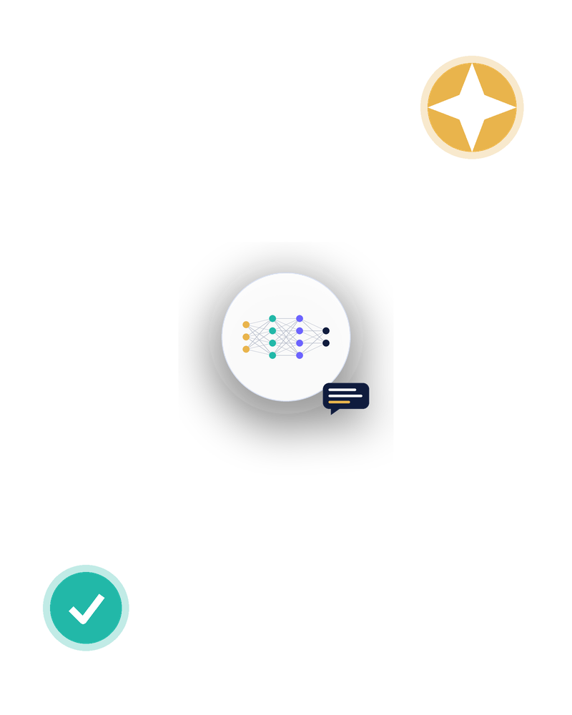
INTERACTIVE ACTIVITY
Fix the Prompt
STARTING PROMPT
“Write about renewable energy”
1 Add context, a role or constraints
2 Specify the output format you want
3 Run it and compare with a partner
4 Refine once more based on the result
Notes:
Give students 3-4 minutes to improve the prompt individually, then run it. Ask a couple of volunteers to share their improved prompt and the difference in the response. Close by asking: what's the one habit you'll take away from today?

Slide 15




RECAP
Key Takeaways
AI contains ML, DL and Generative AI
Each is a narrower category inside the one before it
LLMs predict text one token at a time
Using patterns learned during training, within a context window
Good prompts give context and format
Task, context, role, constraints and output format all help
AI can be confidently wrong
Hallucinations and fabricated citations are real risks
You are responsible for verification
Check facts, respect privacy, and follow academic integrity rules
Introduction to AI & Generative AI | Session 0
15
Notes:
Read through the five takeaways quickly. These are the foundation for the next two days, where students will use these same principles for research papers and resumes.

Slide 16
Thank You
Questions and discussion
Next up: putting this into practice with research and resumes.
RS
Rohan Sudhan
3BR23CD002
RA
Rida Arshad
3BR23CD076
Notes:
Open the floor for questions. Remind students this session sets up the tools they'll use hands-on in the next two sessions.

